Slide 1
Faculty Senate Meeting
20 March 2025

Slide 2
Meeting procedure
Only Senators may debate motions
Only Senators can vote
If you are not a Senator, or a proxy, you cannot vote or debate
Do not speak over someone, or out of order
  Raise your hand (For those online please use “Raise Hand” on the Zoom app)
  The President will call on you and then you will have the floor
  Please wait for the microphone
Unless you have been recognized (told you have the floor), you may not speak

Slide 3
I. Call to order
D. Westenberg, President

Slide 4
II. Roll Call
J. Schlegel, Secretary

Slide 5
III. Consent Agenda
D. Westenberg

Slide 6
Consent Agenda
Approval of the 27 February 2025 Minutes
Campus Curriculum Committee moves to approve CC and DC forms from their last meeting

Slide 7
IV. President’s Report
D. Westenberg
20 March, 2025

Slide 8
Shout Out!
Thank you!
Faculty, Staff, and Students
Helping the Community

Slide 9
IFC – 3/10/2025, In-person
Topics discussed
IFC Rep - committee to oversee faculty analytics (i.e. MyVita)
Raised concerns about “Dear Colleague” letter
  What is “covert discrimination”
Concerns about restrictions on Visas from certain countries
Concerns about vague terminology in CRRs on P&T
  i.e. defining “sustained” research
Addressing funding challenges – still uncertain

Slide 10
IFC – 3/10/2025, In-person
Presentations
Preparing for Title II – digital accessibility
  New tool – Blackboard Ally – available mid-April
AI policy/guidance – UMSystem webpage mirroring Mizzou
Still streamlining software approval process
  Focus on “click-through” agreements
  Software to track approvals for all 4 campuses
State budget – still uncertain
Legislation being watched
  Transfer bill and Degree bill

Slide 11
Curators Meeting on Campus
April 17
  BioPlex Groundbreaking on April 16
  Recommended 10 students for reception with Curators

Slide 12
Campus Matters
Provost search
  Deadline Monday for applications
F&O General Listening sessions (virtual and in person)
  Schedule and topics on Percipio (umsystem.percipio.com)
Administrative Review Surveys open until tomorrow

Slide 13
Campus Matters
Leadership Meetings
See Miner Momentum for topics discussed
Enrollment updates – Transfer partnerships
Kummer College initiatives
AI initiatives – connecting research and education
Budget reduction scenarios
Scenarios for upcoming Board meetings
VC for Engagement and Outreach

Slide 14
Campus Matters
Shared Governance Summit thoughts
Shared Governance Summit thoughts
  Staff support for relevant FS Committees
    Focus on strategic plan SFAs
  Revision of existing policy memoranda
    FS more engaged in proposing policy?
  Partnering with Faculty Affairs
  Faculty Senate Budget

Slide 15
Campus Matters
Good News
Faculty, Staff, and Students Stepping up to help the community.
It's the first day of SPRING!

Slide 16
Be Involved
Be Engaged
Do Something

Slide 17
V. Campus Reports
A. Staff Council
K. Walkup

Slide 18
Spring 2025 Staff Appreciation Week
Award nominations March 17 to April 11
Staff Excellence Awards
Bridge Builder
Student-centric
Excellence in work
Hospitality
Outstanding Newcomer Award
Outstanding Faculty Award

Slide 19
Spring 2025 Staff Appreciation Week
Not finalized, but get excited!
Date: May 19-22, 2025 - “Spirit Week”
19 - TBD
20 - TBD
21 - Staff Day - Opening Ceremony
22 - Mammogram Truck
Location: Innovation Lab
Theme: Game Show

Slide 20
V. Campus Reports
B. Student Council
M. De La Hunt

Slide 21
Referendum Results
Student Body President
  Aiden Wallace Pickett Elected
  Term begins April 29th
    New Vice Presidents also elected, term starts same date
Proposition A: Fee Increase
  Increase by $29 to $30 (pending inflation numbers)
  Supports major projects including hiring two new well-being staff and renovations to the rec center
  Passed
Amendment 1: Constitutional Amendment
  Updates terms and makes various situational tweaks to the Constitution of Student Council
  Passed

Slide 22
Update on Current Projects
Mental Health Initiatives
  Student Council and the Greek Life office holding Well-Being training April 5th from 4-6 PM
Academic Information Availability
  Moving slower than expected, still in progress
  Pats, Election Week, and Tornado have contributed to delay
Policy Committee
  Keeping an eye on this, current main concern is with campus closure policy
Tornado
  Major kudos to students, staff, and faculty who turned out to support the city
  Concerns with how the Student Body is currently being viewed by the local population

Slide 23
Questions?
Contact Information
stuco@mst.edu
(573) 341-4280
Room 232, Havener Center
https://stuco.mst.edu
Office Hours available on our website
Martin De La Hunt
martin.delahunt@mst.edu

Slide 24
V. Campus Reports
C. Council of Graduate
Students

Slide 25
Council of Graduate Students
No report

Slide 26
VI. Committee Reports
A. Budgetary Affairs
B. Lea

Slide 27
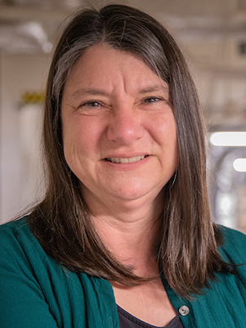
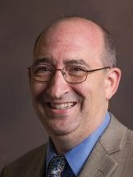
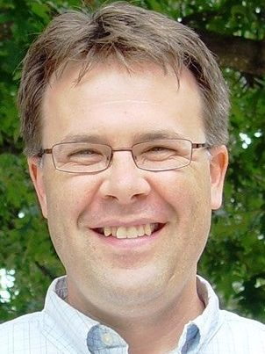
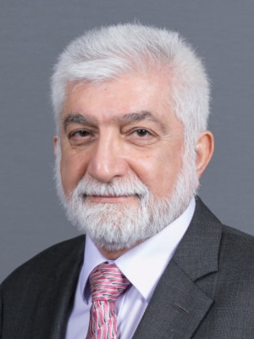
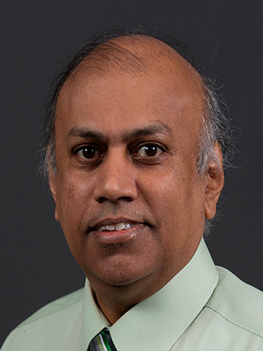
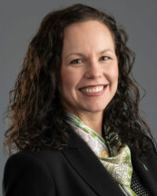
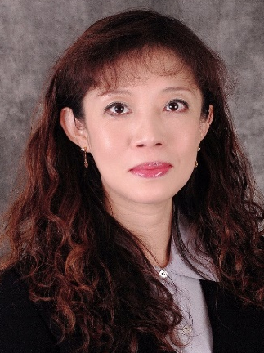
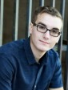
Budgetary Affairs Committee (BAC)
Information: VCFO Budget Update April 2&3
Emerging Issues & Referrals
  Trends – Number of Positions and Total Salary
Financial Position
Dr. Melanie Mormile mmormile@mst.edu
CASE
Dr. David Bayless dbayless@mst.edu
CEC
Dr. Kelly Homan khoman@mst.edu
CEC
Dr. Ali Hurson hurson@mst.edu
CEC
Dr. Jag Sarangapani sarangap@mst.edu
CEC
CFO Alysha O'Neil alysha.oneil@mst.edu
Finance & Operations
Dr. Bih-Ru Lea (Chair) leabi@mst.edu
Kummer College
Mr. Logan Garton wgcf2@mst.edu
Student Council, Civil Eng

Slide 28
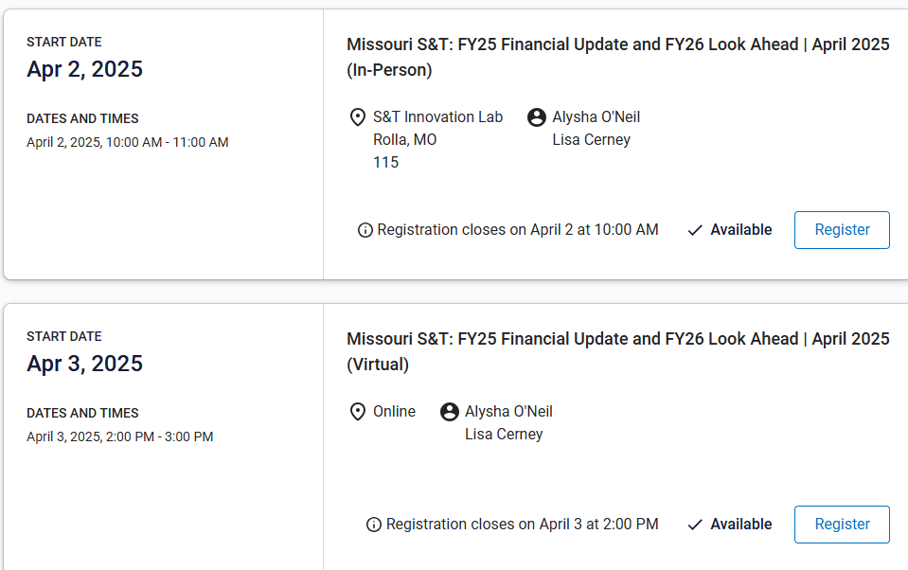
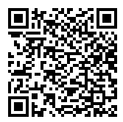
1. Information: VCFO S&T: FY25 Financial Update and FY26 Look Ahead
https://umsystem.percipio.com/liveCourse/acde9090-6a38-42ff-b25a-944d13cf1d88
Notes:
https://umsystem.percipio.com/liveCourse/acde9090-6a38-42ff-b25a-944d13cf1d88

Slide 29
Referrals & Emerging Issues
1. Salary Trends: Administrators, Faculty, and Staff
Background Info
Today: Personnel classification 2019 - 2024 data
Positions
Salary
Inquiries were made in the 1-15-2025 BAC meeting. Ms. Lisa Cerney indicated that she could provide this information in 2 weeks.
Updates: Some discussions on a similar topic in the 1-18 RP&A meeting. Ironically, a similar request was received after the 1-30 faculty senate meeting.
BAC on-going tasks for 4-24 Faculty Senate Meeting:
Public R1/R2, 5k-20k Enrollment, MO Border states
Public R1/R2, 5k-10k Enrollment, National

Slide 30
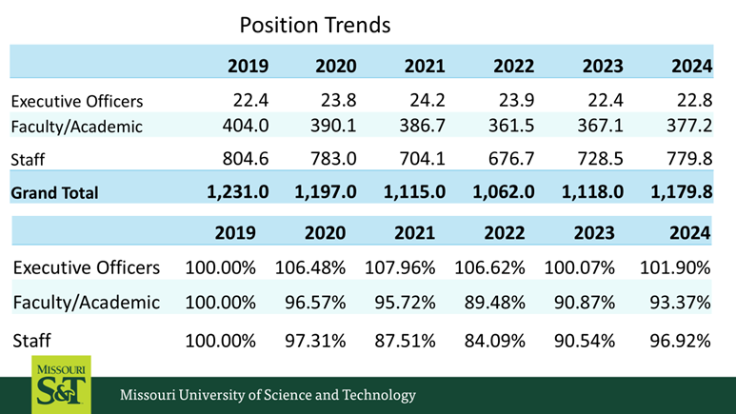
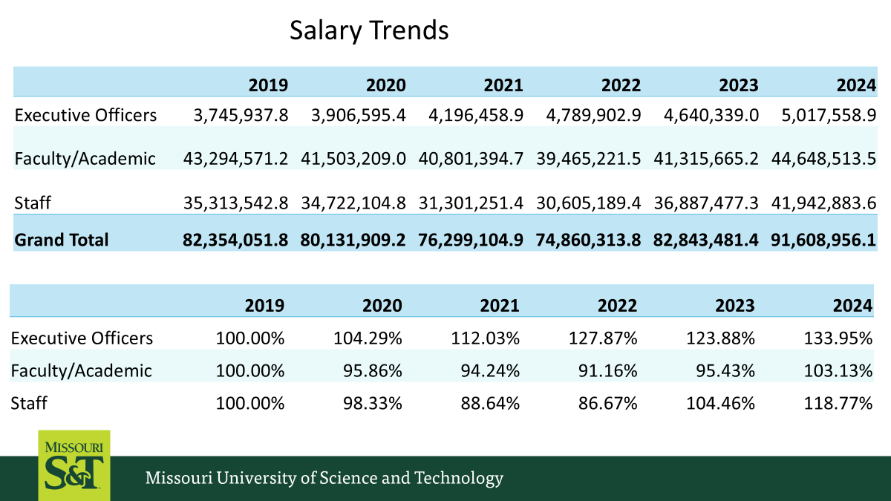
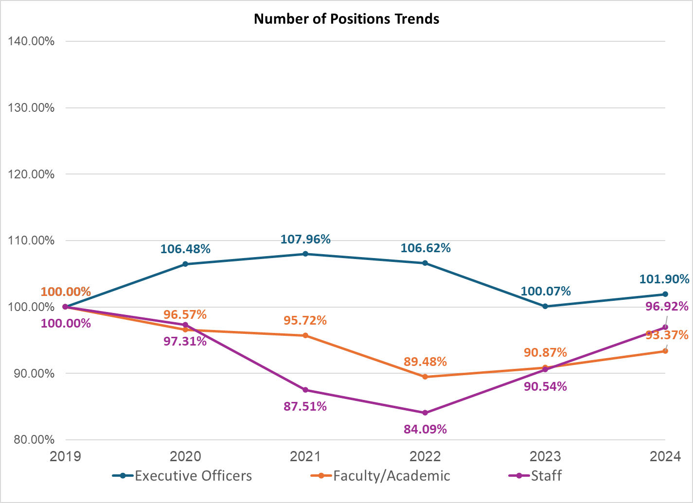
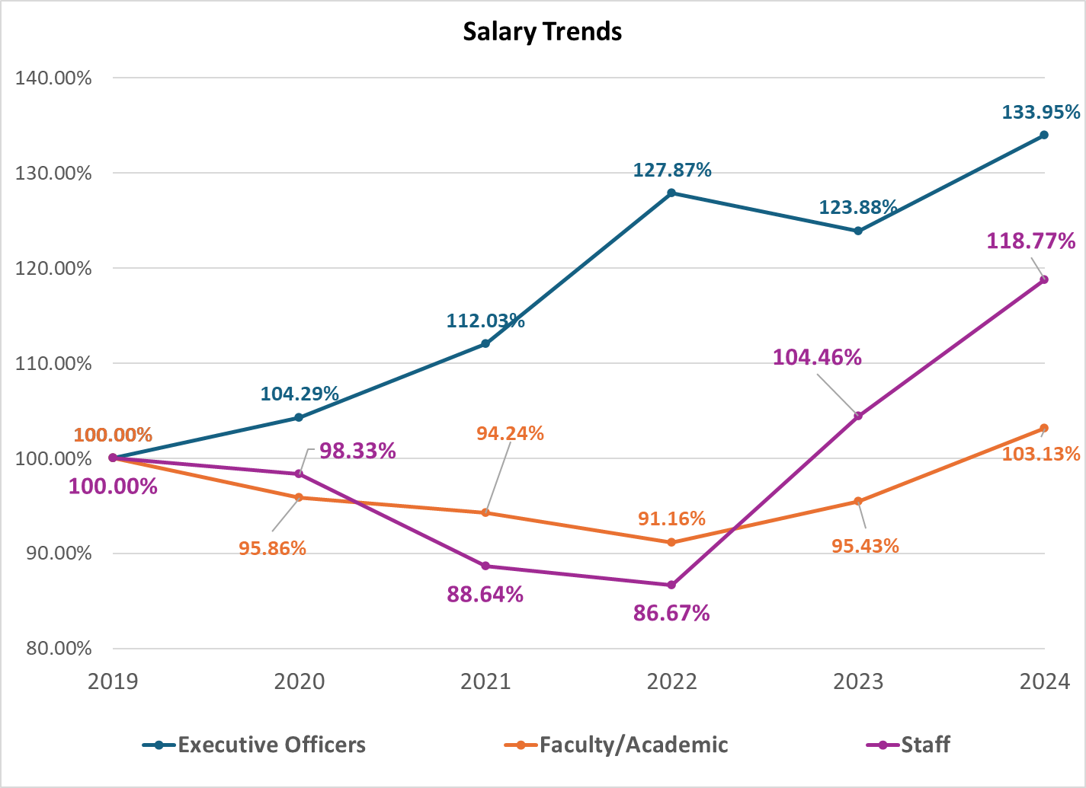
Trends – Number of Positions and Total Salary

Slide 31
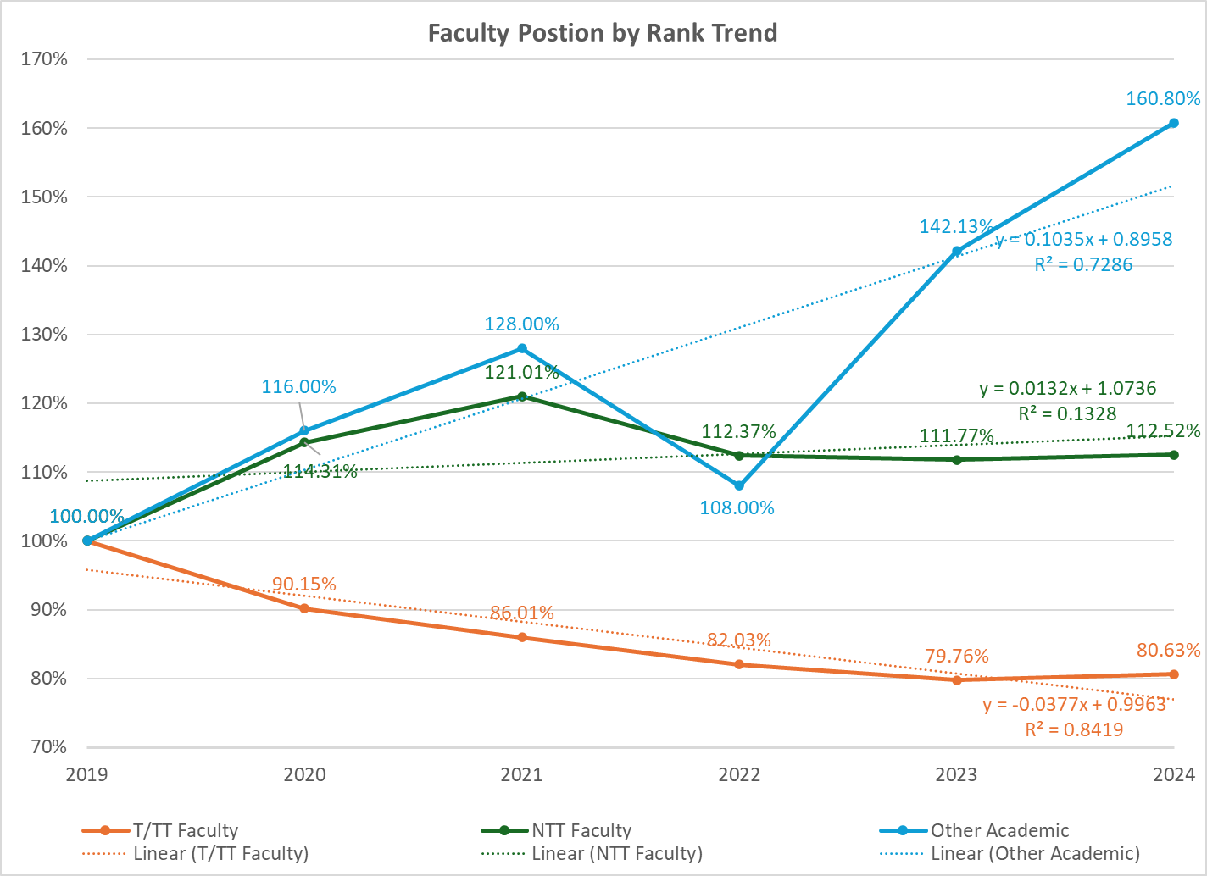
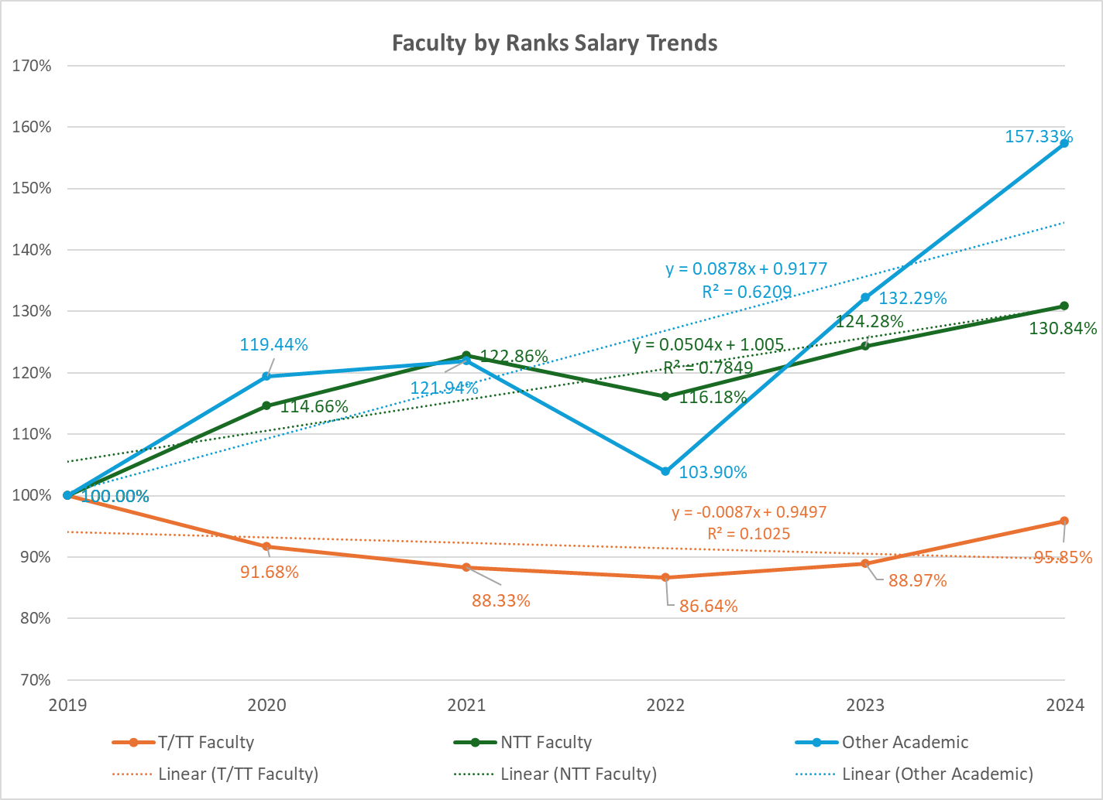
Trends – Number of Positions and Total Salary
Other Academic primarily includes full-time post doc fellows, visiting scholars/profs, and Librarians (Appendix 1).
Increasing trend: NTT & other Academics
Decreasing trend: T/TT

Slide 32
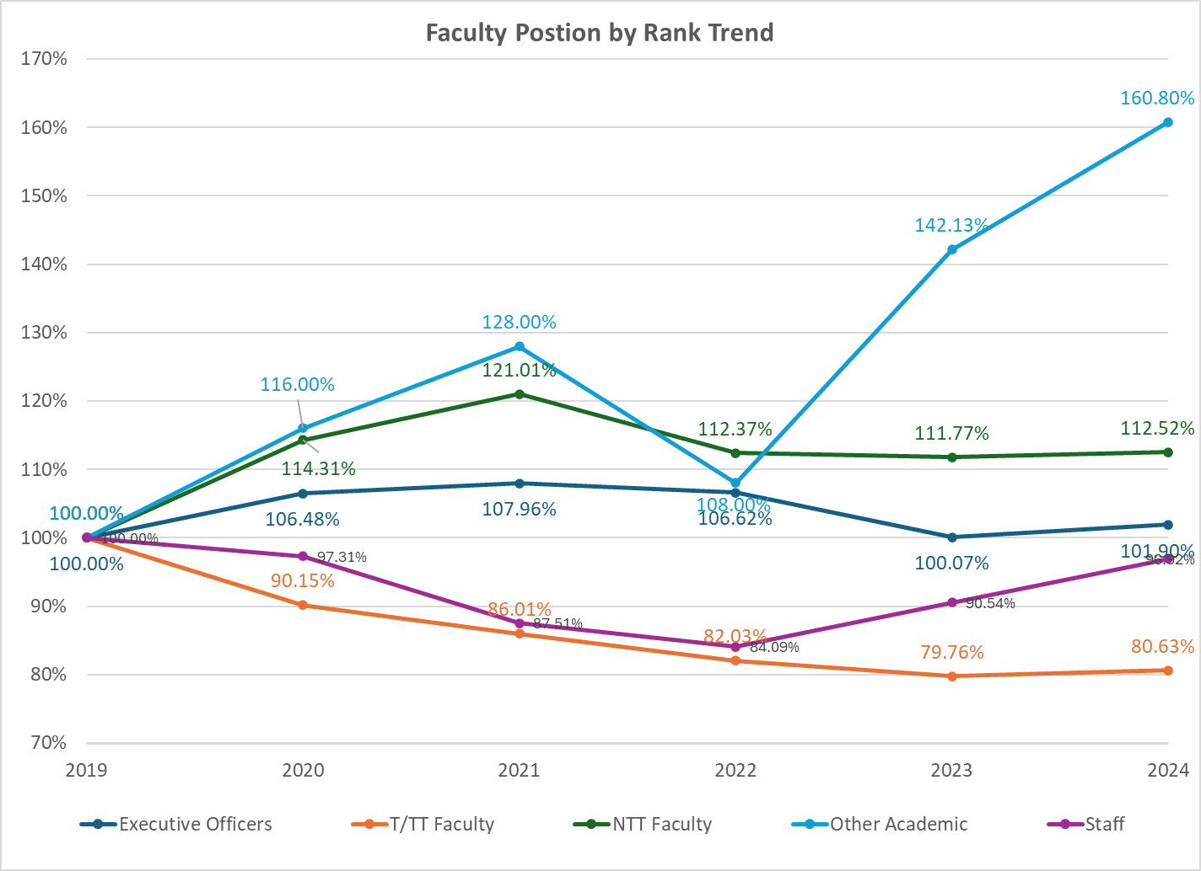
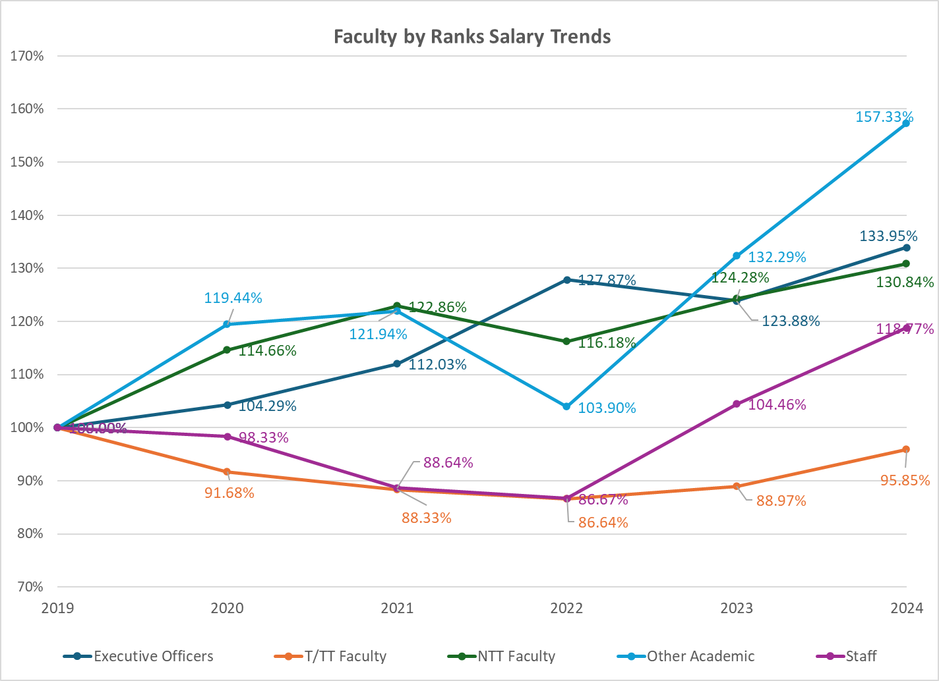
Trends – Number of Positions and Total Salary

Slide 33
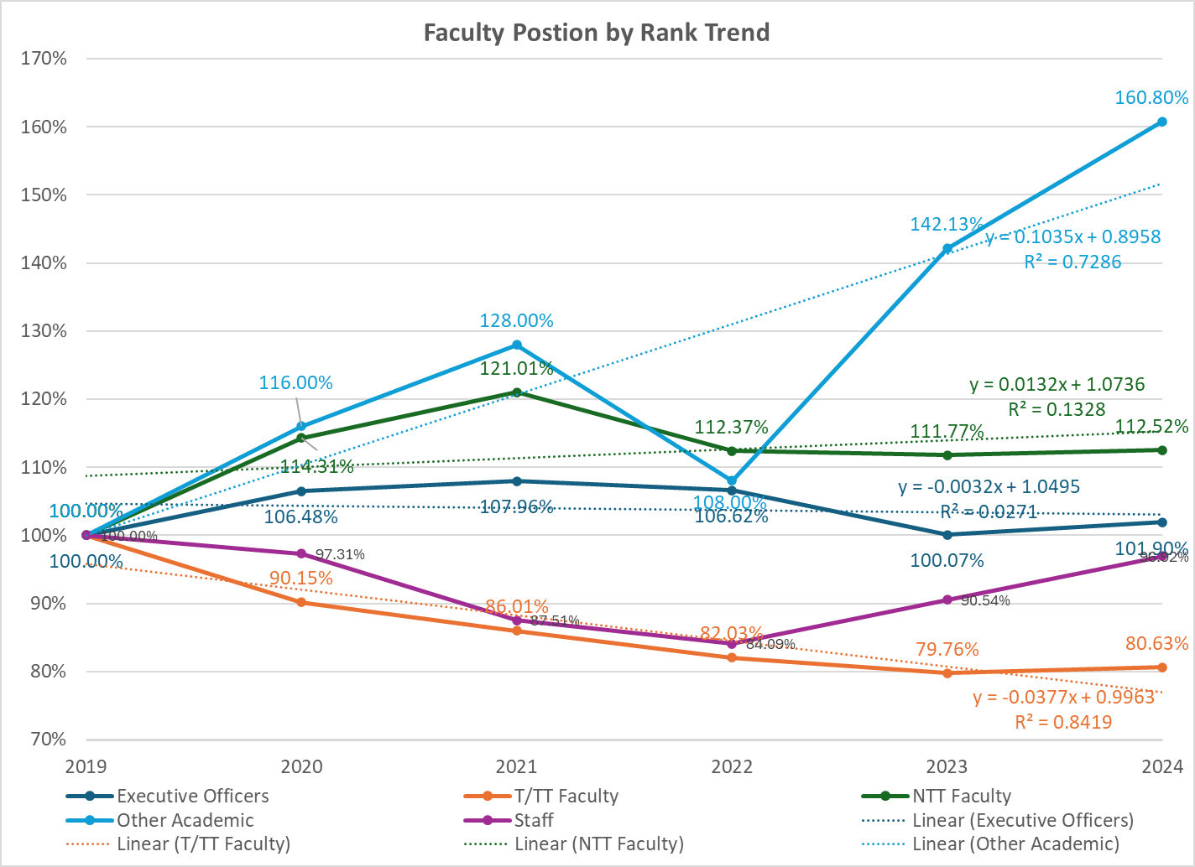
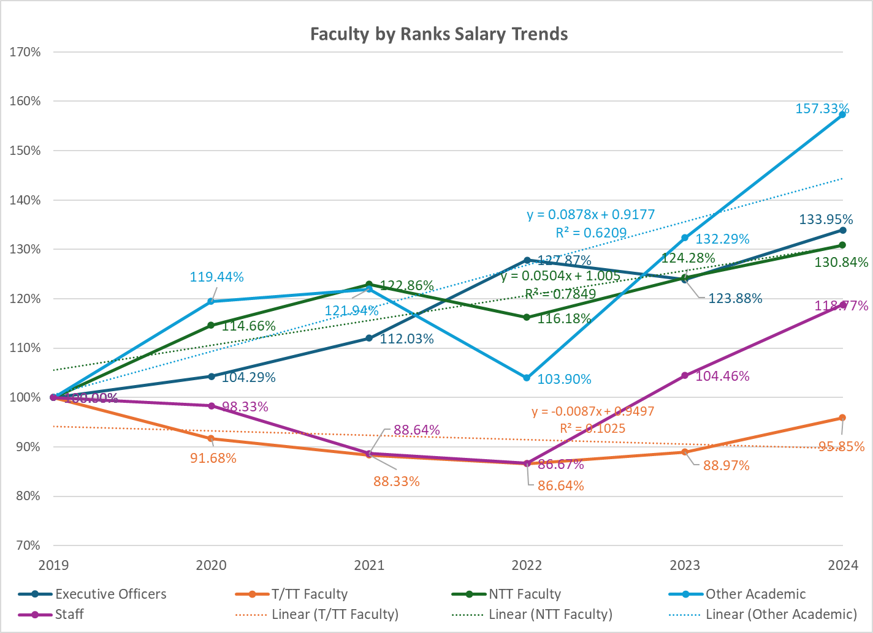
Trends – Number of Positions and Total Salary
Increasing trend: All except T/TT
Decreasing trend: T/TT

Slide 34
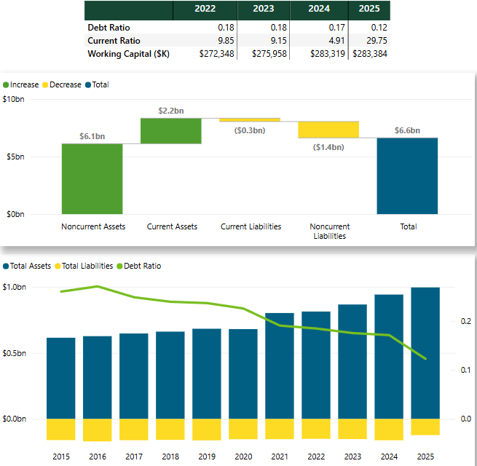
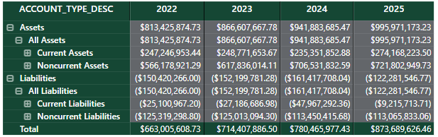
Financial Positions
Decreasing in Debt ratio over time
  Increase in current assets and noncurrent assets.
  Decrease in current liabilities and noncurrent liabilities
Note: 2025 data as of March 18, 2025

Slide 35
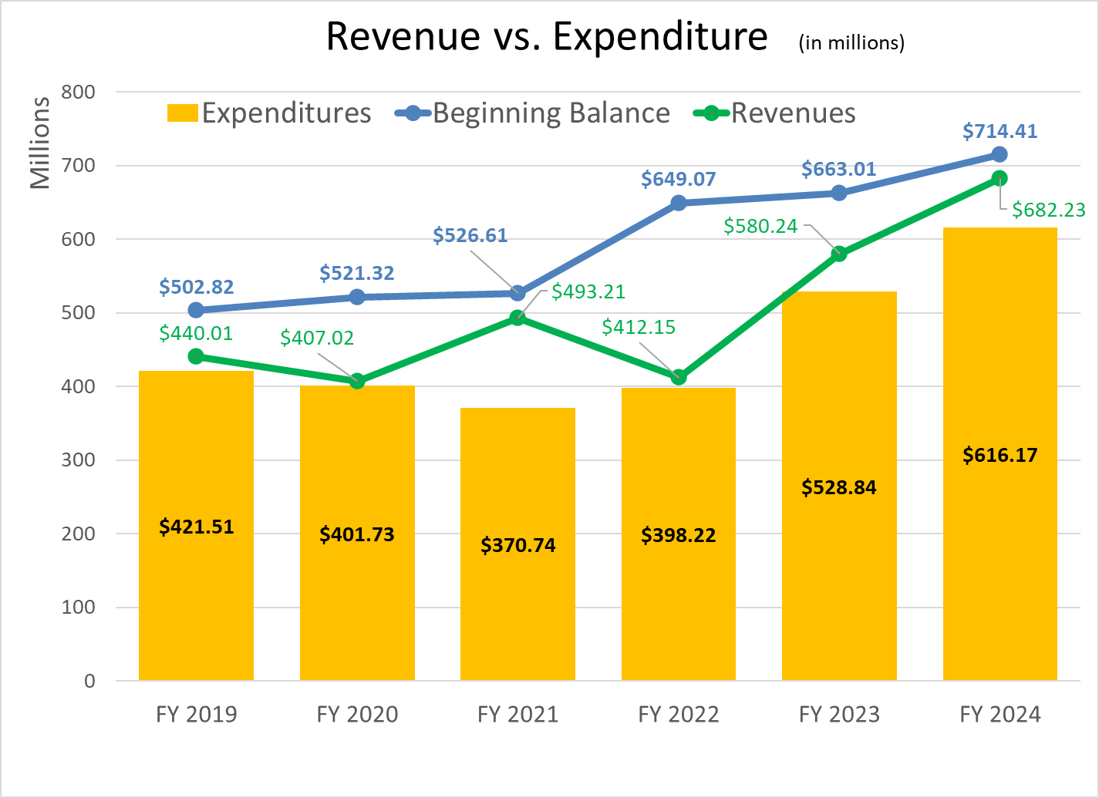
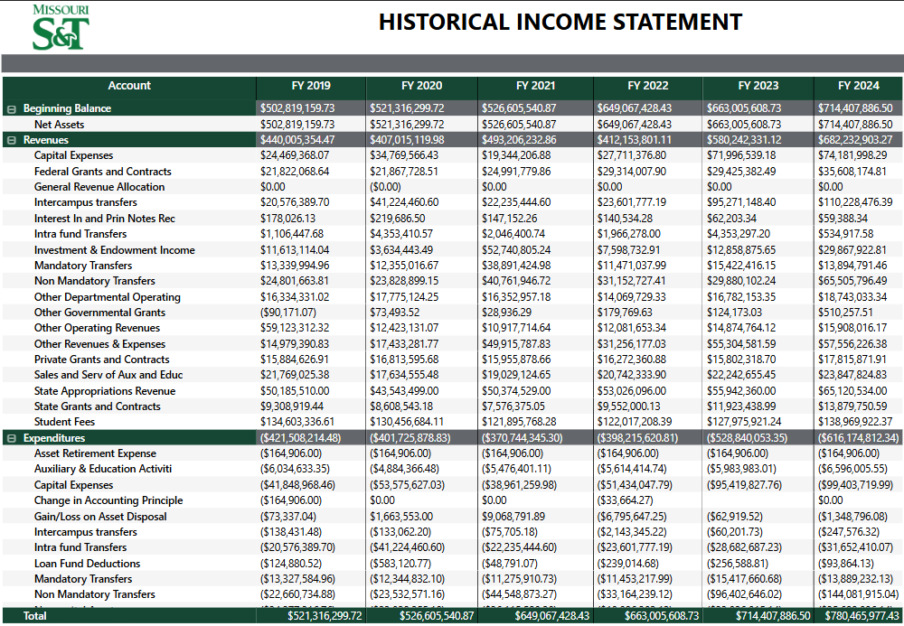
Financial Positions
Expenditures / Revenue | FY 2019 | FY 2020 | FY 2021 | FY 2022 | FY 2023 | FY 2024
 | 95.8% | 98.7% | 75.2% | 96.6% | 91.1% | 90.3%

Slide 36
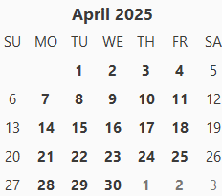
Information: Next Topic Request Due Date: 11:59 pm, 4-7-2025
All topics or questions submitted by April 7 will be reviewed at the March 5 BAC meeting, where the BAC will assess the following
  urgencies and priorities of topics/questions
  data collection timeline
  Approach(es) to addressing each topic
  communication plans
Findings will then be communicated to the faculty during the April 24 Faculty Senate meeting, another future meeting, or an appropriate communication channel.
Faculty Senates Meeting
Budgetary Affair Meeting
RP&A Meeting
DCC Meeting

Slide 37
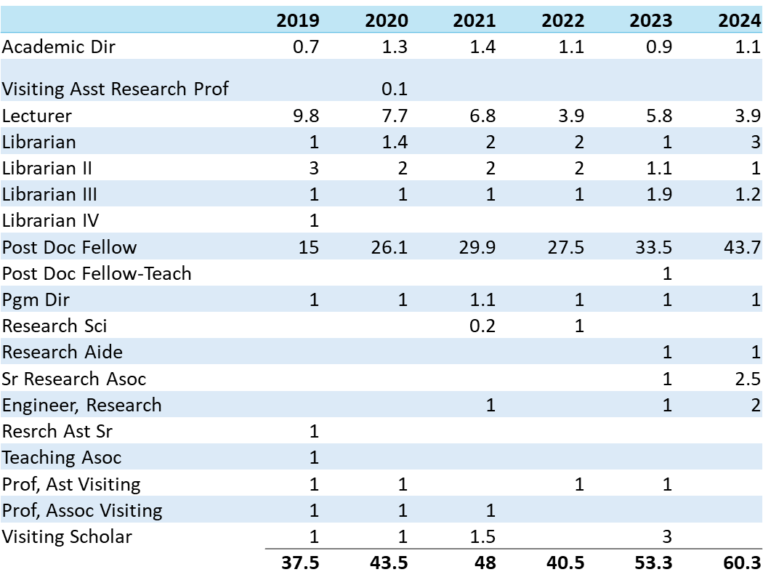
Appendix: 1
Other Academic primarily includes full-time post doc fellows, visiting scholars/profs, and Librarians.

Slide 38
VI. Committee Reports
B. Campus Curricula
P. DeWitt

Slide 39
CCC Motion on General Education
Catalog language for new General Education Requirements
General Education Credit Hour Requirements
Foundational Goals – (31 credit hours total, distributed in the following areas)
-Mathematical Science (3 credit hours) Choose from Math 1120, 1140, and Math 1210 or higher course number.
-Natural Sciences (7 credit hours including a minimum 1 credit hour of lab) Choose from at least two specific disciplines: Biology 1113 or higher, Chemistry 1301 or higher, Geology 1110 or higher, Physics 1111 or higher.
-Communications (6 credit hours) English 1120 (a) and choose one course from ENGL 1160, ENGL 3560, or Speech & Media 1185.
-Humanities, Arts, and Social Sciences (15 credit hours) Choose courses from History, Art, Music, Theater, English and Technical Communication, Philosophy, Political Science, Psychology, Economics, Etymology, or Foreign Languages
- 6 credits in the Humanities and Fine Arts, selected from two specific disciplines: History 1300*, 1310*, Art 1150, Music 1150, Theater 1150, and English 1211, 1212, 1221, 1222, and 1231 (or Non-prerequisite Literature).
- 6 credits in the Behavioral and Social Sciences, selected from two specific disciplines:
History 1100, 1200*, 2110, Philosophy 1105, 1115, Political Science 1200*, Psychology 1101, Econ 1100 or 1200, Foreign Languages 1101, 1102, and 1180.
- 3 additional credits from any of these Humanities, Art, and Social Sciences disciplines
* Fulfills Williams Law
Notes:
It is understood that language requirements for BA, Experiential Learning Requirements for both BA and BS, Missouri Higher Education Civics Achievement Examination

Slide 40
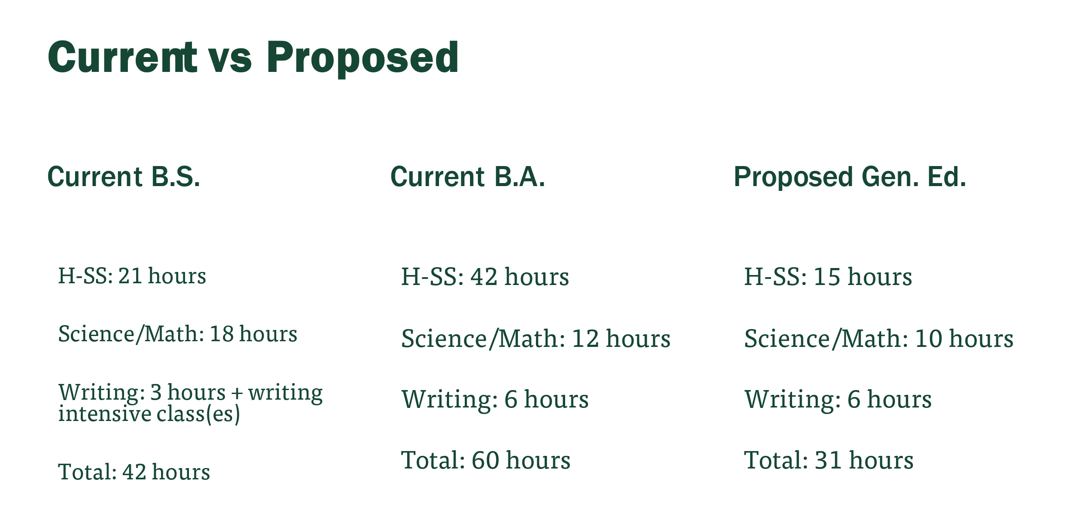
Including Engineering

Slide 41
CCC Motion on General Education
Discussion: Questions or comments?
The General Education Program was approved by the Missouri S&T Campus Curricula Committee.
The Missouri S&T Campus Curricula Committee moves that the Faculty Senate approves the General Education Program.

Slide 42
VI. Committee Reports
C. Facilities Planning
M. Zawodniok

Slide 43
Construction Work on Campus - Updates
Series of campus presentations on the construction work completed – slides available:
  Campus Construction Update
    https://mailmissouri-my.sharepoint.com/:b:/g/personal/mjzx9c_umsystem_edu/EeAZZLPUHEtNjfszf04649gB_-zBvGzL3cxCufOiO8BxAQ?e=Y6BV5y
  Physical Plant Maintenance Strategy and Update
    https://mailmissouri-my.sharepoint.com/:b:/g/personal/mjzx9c_umsystem_edu/ESoD03ijidxNkRIOY6oLEEUBoQKmrr86jU_GlgKjPiPfGw?e=1ZSi0Y
  Space Planning Strategy
    https://mailmissouri-my.sharepoint.com/:b:/g/personal/mjzx9c_umsystem_edu/EbLcIlYuYt5OiQd5bdGQWjkBPB8nonRTN8lKrClLD_srUA?e=TIaLrh

Slide 44
VI. Committee Reports
D. Committee for
Effective Teaching
J. Schramm

Slide 45
Committee for Effective Teaching
J. Schramm
CET moves that the unweighted average of the first 5 and bottom 9 questions on the student evaluation of teaching be reported separately, along with the rest of the SET information.

Slide 46
VI. Committee Reports
E. ITCC
D. Stutts

Slide 47
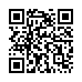
ITCC Meeting on March 20, 2025
Survey of IT performance is still open (subcommittee headed by Dr. Zawodniok)
  Survey CLOSES on March 21, 2025.
    Emails and reminders sent to faculty and staff
    Link: https://mst.qualtrics.com/jfe/form/SV_e3rQr9dCkuKV8Fg
    Report from survey will be presented afterwards
  As of Tuesday – 352 responses
    229 - staff
    112 - faculty
    11 - other
  ITCC plans to repeat survey twice a year to track
  progress and update goals for IT/ITCC

Slide 48
Access Changes – Medium Term
 | OLD |  |  | CURRENT
Platform | Enrollment Period | Privilege Duration | Uses per Request | Enrollment Period | Privilege Duration | Uses per Request
Microsoft | 7 days | Up to 7 days from retrieval | 1 | 6 months | 12 hours | Unlimited
  Less Secure
  Balances Convenience and Risk
  Will Require Accountability
  Will be Replaced in the Future

Slide 49
VI. Committee Reports
G. Personnel
D. Westenberg

Slide 50
Personnel Committee
Dave Westenberg
Faculty/Staff Climate Survey
  Approved conducting the survey in April
  Same questions as 2024
Completed revisions of Teaching Improvement plans
  Present in April meeting

Slide 51
VI. Committee Reports
G. Tenure Policy
M. Nath

Slide 52
Proposed Timeline Synopsis
Month/Timeframe | Action | Month/Timeframe | Action | Month/Timeframe | Action
March 2025 | List of Mandatory tenure applicants sent to dept | April 1 (2025) | Confirmation of P&T candidates | April - August (2025) | External letters sought. Submission of dossier
Jan 2026 and annually thereafter | Request tenure clock extension | Jan - April (2026) | Discussion and deliberation of tenure extension request | April (2025)* | Candidates notified of acceptance or denial of extension request
*[If extension is not granted, the candidate still will have time to prepare and submit dossier.

Slide 53
Motion 1
Currently there is no recommended timeline and the committee feels (anonymously) that we should include the following phrase and timeline for tenure extension request.
Motion 1: The committee moves to include a timeline in the tenure procedure guidelines and the by-laws, by which to make the request for tenure extension.

Slide 54
Motion 2
The committee moves to adopt the following timeline to request tenure extension:
“Requests for tenure extension must be made by the beginning of the calendar year (January) during which mandatory tenure application is due.”

Slide 55
VI. Committee Reports
H. Rules, Procedures, &
Agenda
K. Dolan

Slide 56
Grad Fac committee
Graduate faculty needs 2 members elected by faculty senate to help form a committee for graduate curriculum update process required by the bylaws.
Need to include that in the April elections.
RP&A moves to appoint 2 members to the Graduate curricula committee until the April elections

Slide 57
VII. Unfinished Business
D. Westenberg

Slide 58
VIII. New Business
D. Westenberg

Slide 59
IX. Q&A with the Provost
C. Potts, Provost

Slide 60
X. Announcements
D. Westenberg

Slide 61
XI. Adjourn

Slide 62
Thank You
D. Westenberg
President, Faculty Senate
djwesten@mst.edu
facultysenate.mst.edu

